Slide 1







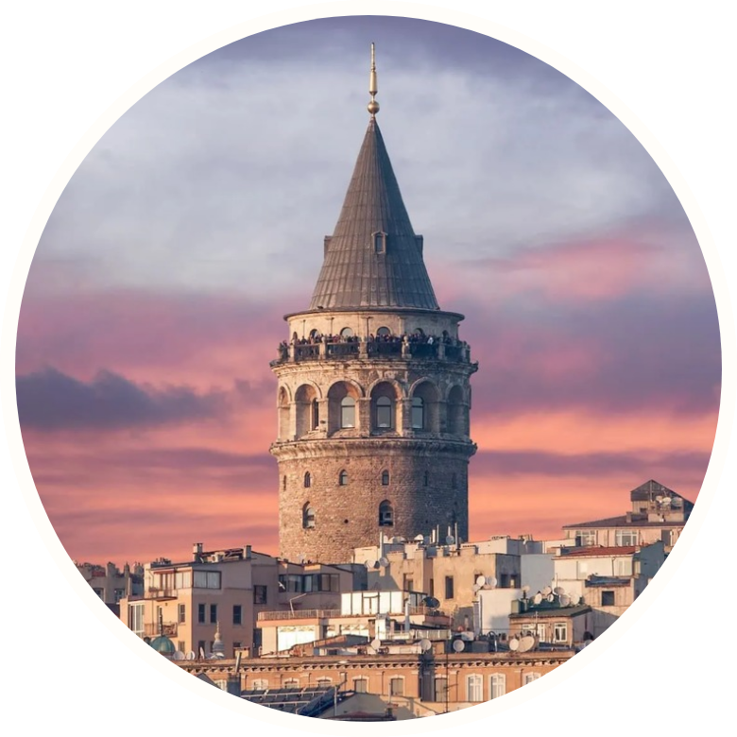




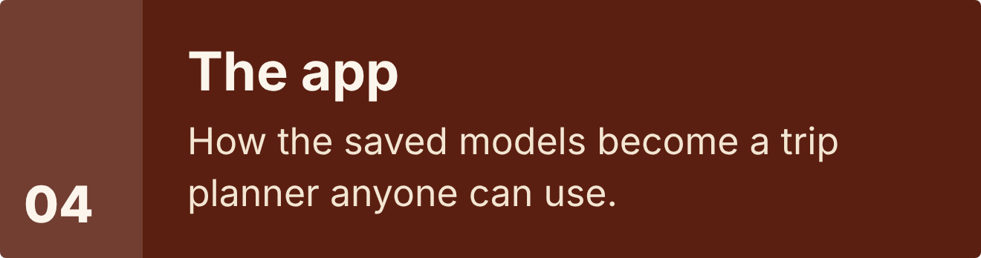





Notes:
Then the app, built on those models.

Slide 2
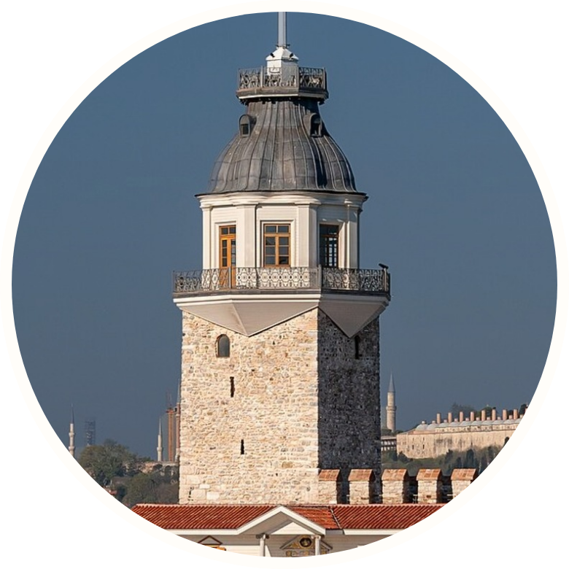





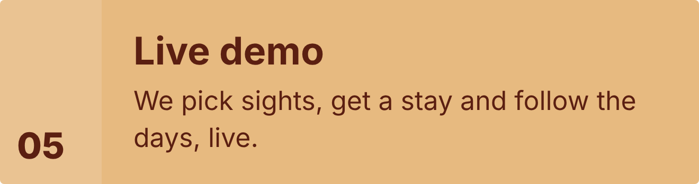

Notes:
And we finish with a live demo.

Slide 3
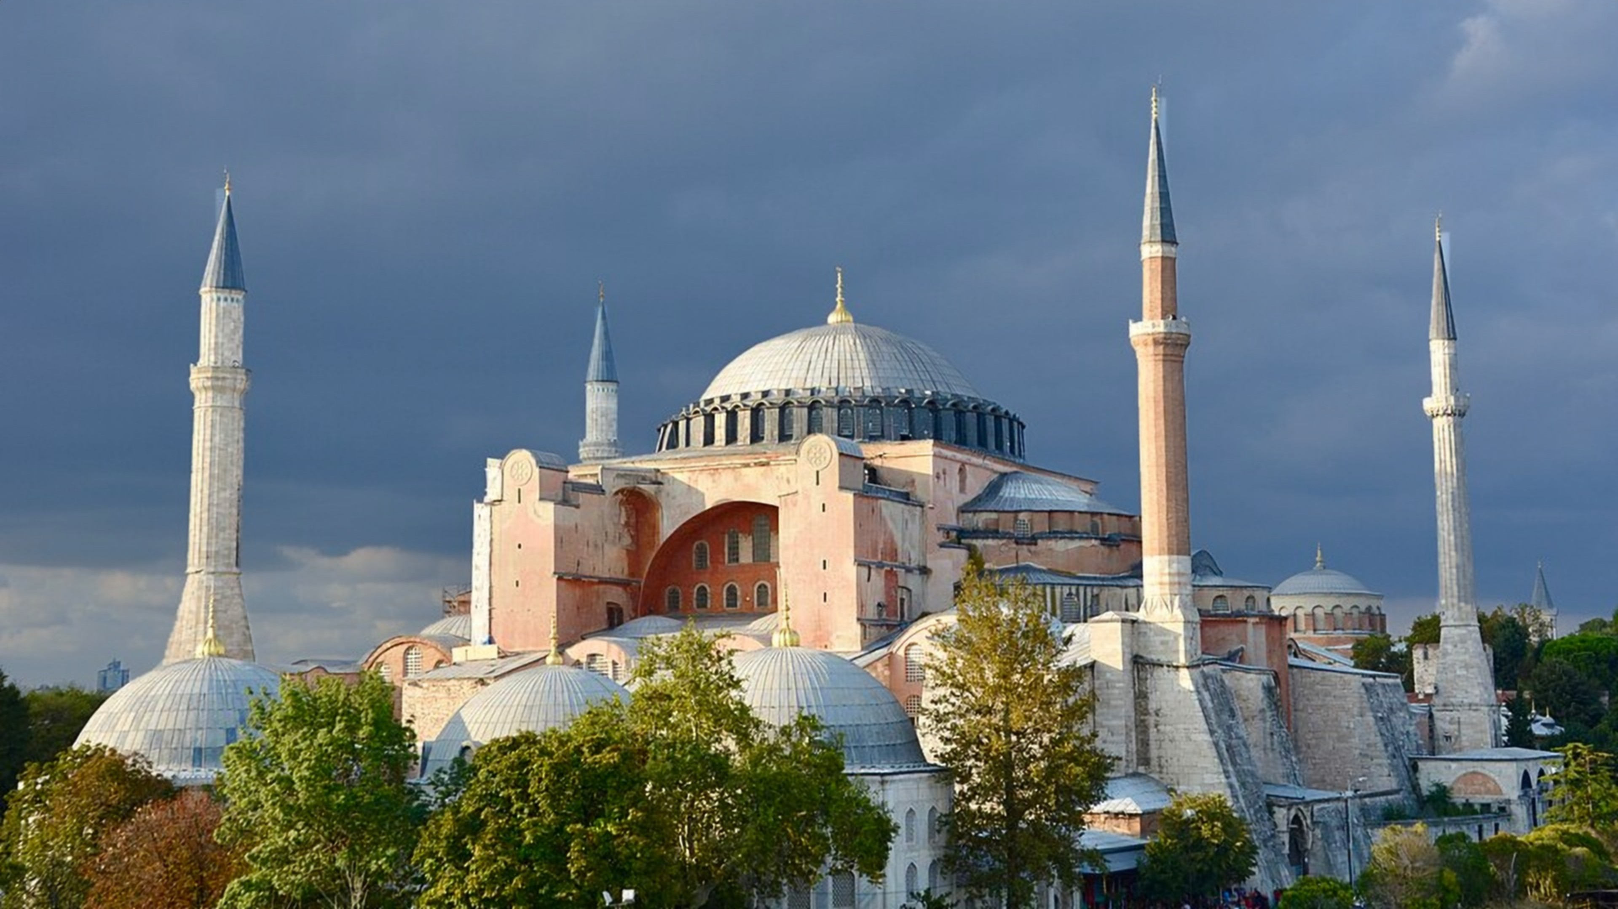
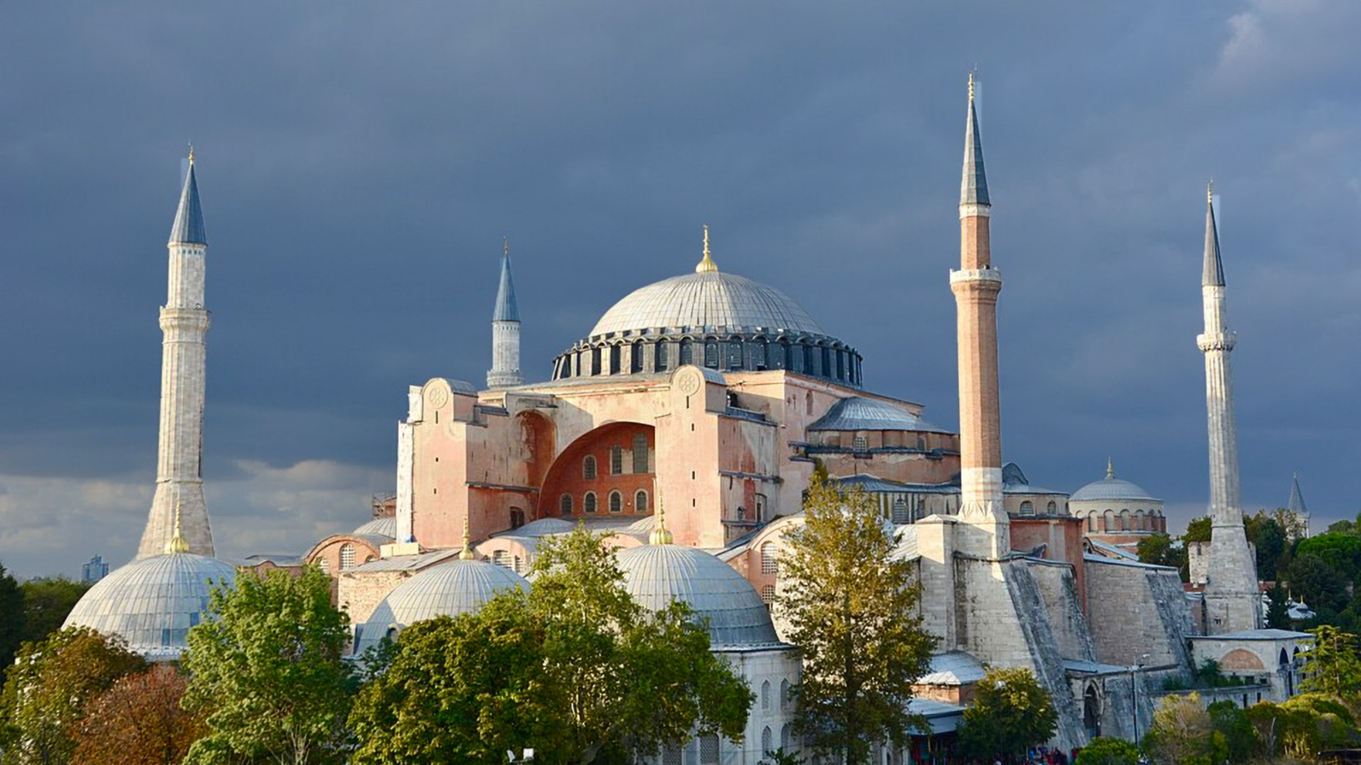

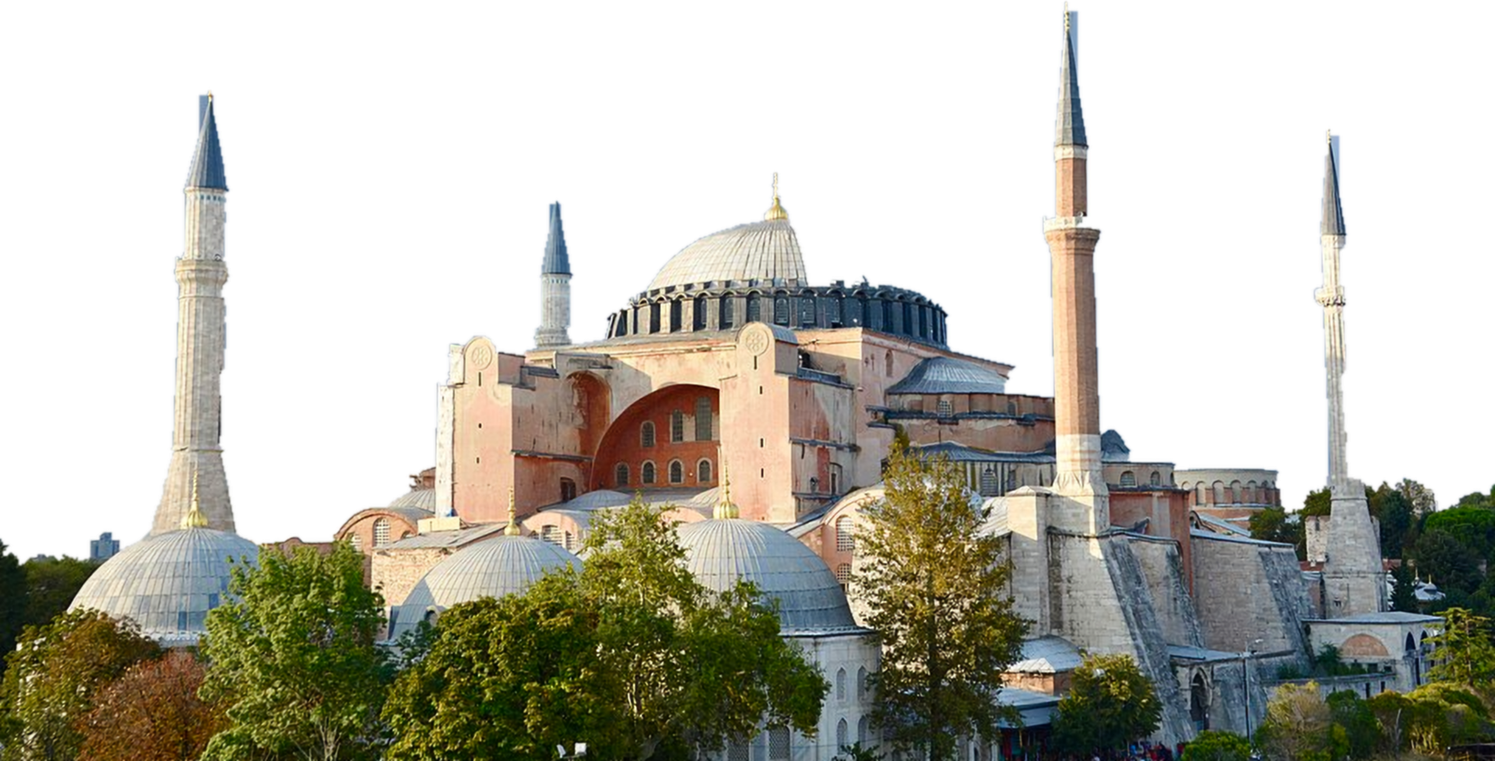

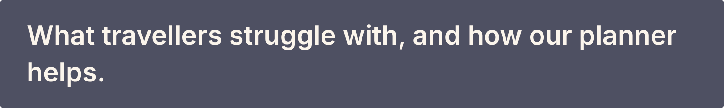

Notes:
Part one is the idea: the problem we saw and our answer.

Slide 4












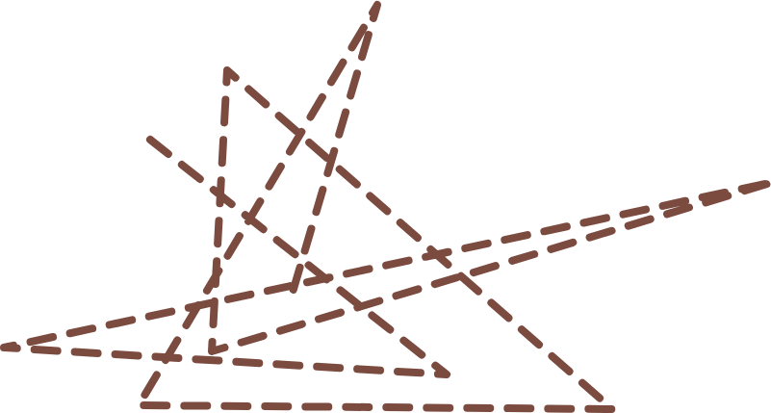



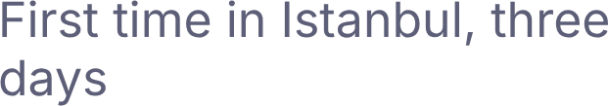













Notes:
Ammar is an example traveller with three days and ten sights. Planning on his own, his route zigzags across the Bosphorus and the Golden Horn, and he still cannot tell where to stay, whether a price is fair, or how to fit everything in.

